Slide 1
Dark web & breaches

Slide 2
Breaches
Notes:
We are now going to kick off our conversation by discussing Breaches.

Slide 3
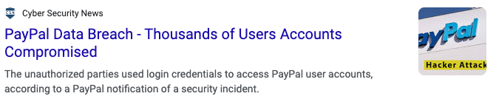
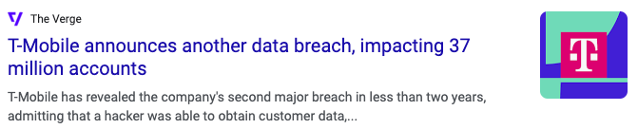
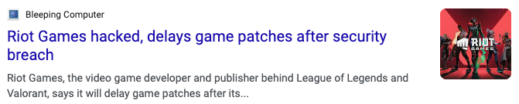
What is a data breach?
A data breach is a security incident, in which information is stolen or taken from a system by an individual unauthorized to do so.
Notes:
Data breaches happen often, very often actually. A nice visualization of their increased prevelence and size can be seen here: https://www.informationisbeautiful.net/visualizations/worlds-biggest-data-breaches-hacks/

Slide 4
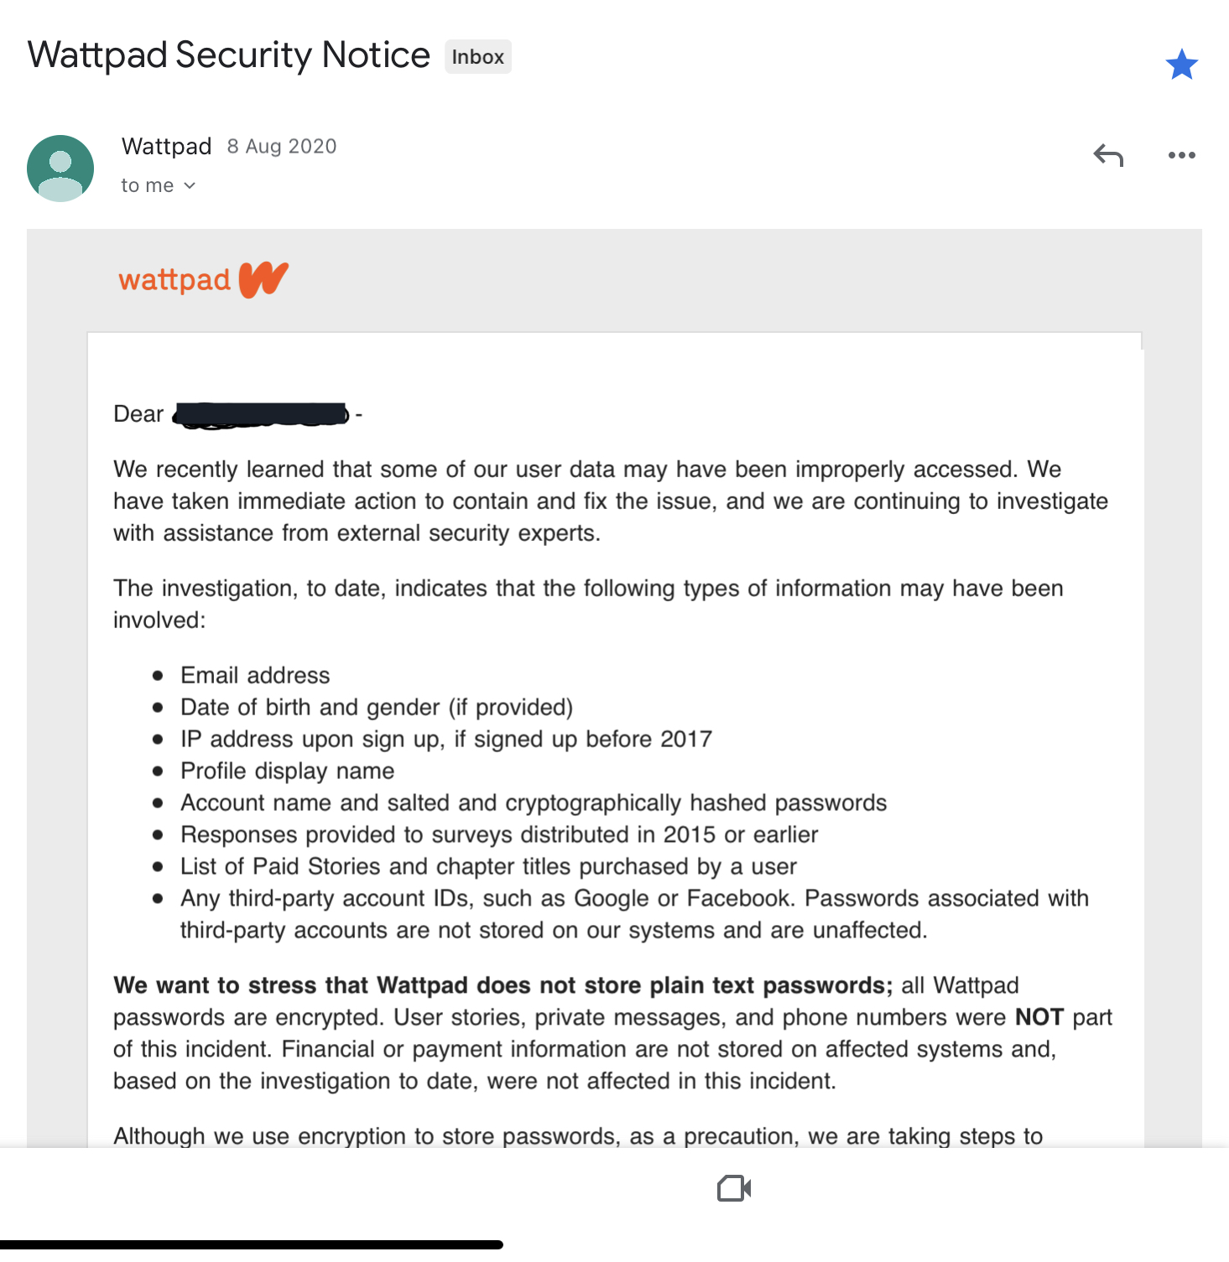
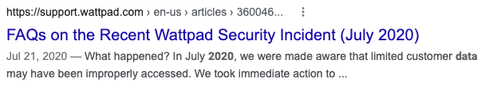
Has my data been leaked?
Head on over to https://haveibeenpwned.com/ and enter your email address to see if it’s been part of a disclosed data breach.
Check your email accounts – if the data for one of your accounts was leaked, the service provider will often send you an email about it.
But be careful! If the email is asking you to follow a link to update your login details, it might be a phishing email!
Always google to confirm an actual breach occurred, by law, it would have had to have been reported!
Notes:
You can check if your email address or password has been leaked as part of a data breach over at https://haveibeenpwned.com/.
Another common way to learn your data was leaked is by being contacted directly by the services that experienced a breach, an example of which is seen in the screenshot above. Remember to always be cautions when receiving emails like this since while they can be legitimate, often times they’re actually phishing emails. The rule of thumb is to never click on any links – if a service says experienced a data breach, google it and if it’s legitimate it should show up as one of the first results since companies are obliged to disclose any leaks.

Slide 5
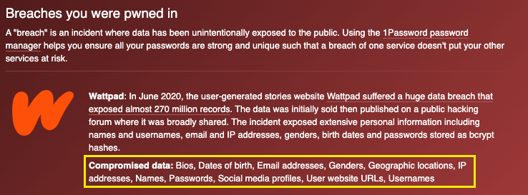

My data was leaked!
What do I do?
Stay calm!
Notes:
The screenshot here was taken from https://haveibeenpwned.com/ from one of the compromised services. If you find your own email being flagged, first thing to do is to stay caml.

Slide 6

My data was leaked!
What do I do?
1
2
3
4
5
Change the password for the compromised account
Confirm what sensitive information was disclosed
Check your account for any suspicious activity
Enable multi-factor authentication
If the account has the ability to perform money movement - freeze the account
Notes:
Go to the website where your account was compromised, log in and immediately change your password. That will prevent anyone from logging in into this account further. Try thinking if you’ve used this email/password combination anywhere else, if you have, go to those accounts too and change the passwords.
Confirm exactly what information was disclosed, going back to point 1, if your username/email/password is now breached, go to those accounts and change your credentials. If it’s credit card details, make sure that the card is expired and if it’s not – freeze it.
Most accounts will allow you too see your usage history, check that you recognize the devices, locations, actions and times that the recent actions were performed for.
Enable multi-factor authentication – this is also called MFA or 2FA
If the account can perform money movement, temporarily freeze your account and make sure you’re able to get a new bank card if needed and that the login details to this account are updated.

Slide 7
The Dark Web
Notes:
Text book type definition of Cybersecurity. Key phrase “ Protect against damage, loss or unauthorised access. “ By utilising Cybersecurity techniques an individual doesn’t make it easy for the Hacker/Attacker. They are no longer an easy target.

Slide 8
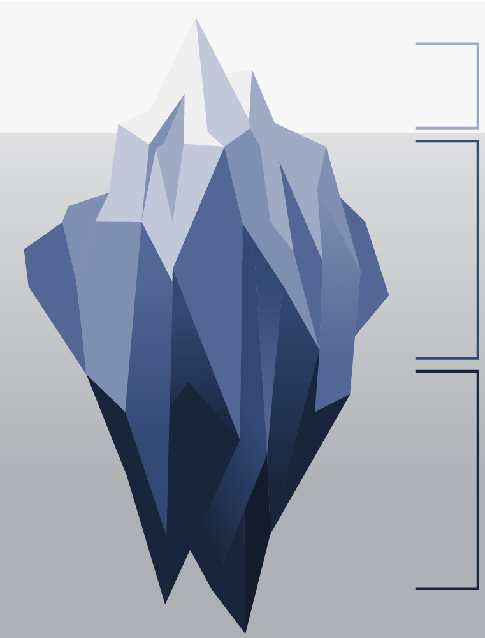
What is the Deep and Dark web?
Surface web
Content indexed by search engines
4%
Deep web
Content not indexed by search engines. Such as those behind a login
90%
Dark web
Content only accessible via special encrypted browser (like Tor)
6%
Notes:
One place stolen data might end up is a part of the internet called the Deep and Dark Web, but what is that exactly? To explain the Deep and Dark Web we use the example of an iceberg. The part visible above the water we call the surface (or open) web, this is the part of the internet indexed by search engines and makes up about 4% of all internet content. It is entirely public and open to anyone. The Deep web is the part just below the surface, still accessible via a normal web browser but not searchable via google etc. This private content makes up the largest proportion of internet content (around 90%) and includes websites that gate their content behind paywalls and logins. The dark web, on the other hand, uses encryption software to provide even greater security. It cannot be accessed via a standard default web browser.

Slide 9
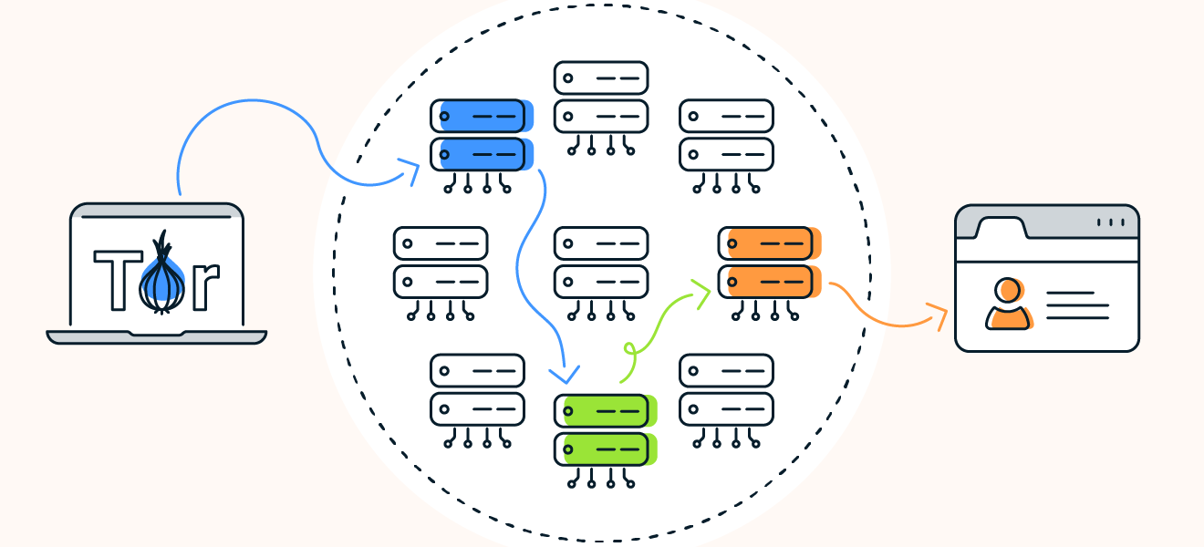
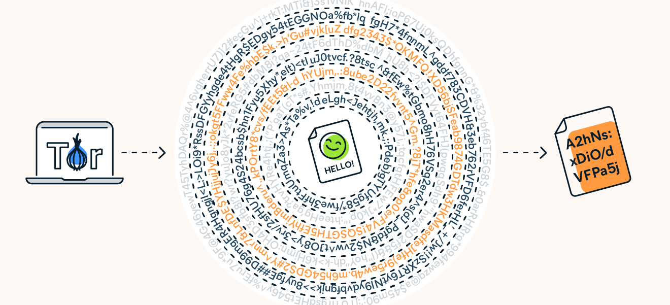
How does Tor work?
Notes:
Dark Web websites end with a .onion address and exist on a network called Tor, which stands for “the onion router”.
Originally developed by the US Navy before becoming open source, Tor is a platform that allows for anonymous internet browsing.
Tor uses onion routing to encrypt and reroute web traffic through Tor’s onion network. After the data is secured inside multiple layers of encryption, the web traffic is transmitted through a series of network nodes, called onion routers. Each router (or node) “peels away” a layer of encryption until the data reaches its final destination, fully decrypted.
This process takes time and as such browsing via Tor is often slow.
Tor is also still vulnerable at the entry and exit nodes. Since internet traffic is not encrypted at these points, data could be intercepted, and IP address exposed. This is why users typically use a VPN in conjunction with Tor.
Source:
https://www.avast.com/c-tor-dark-web-browser

Slide 10
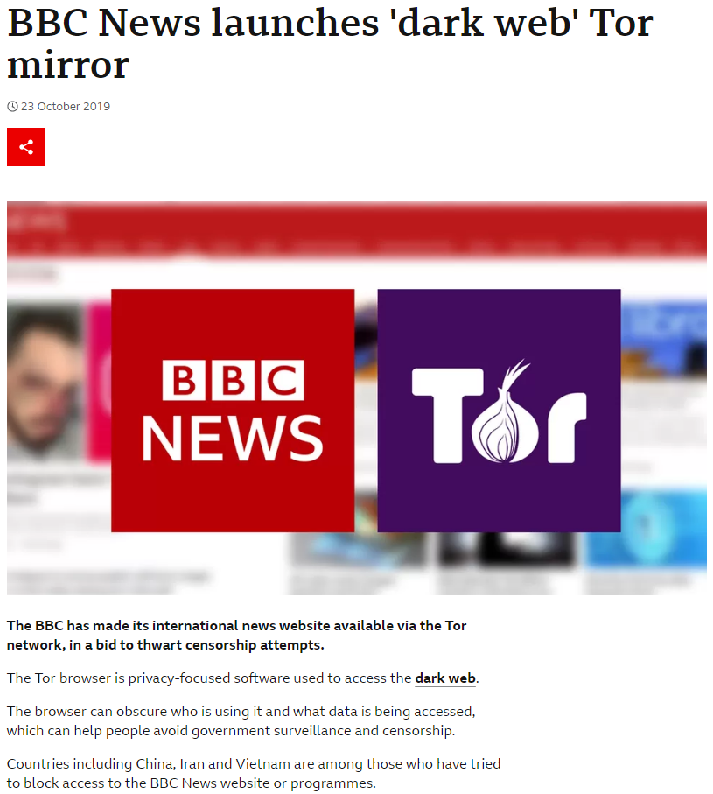
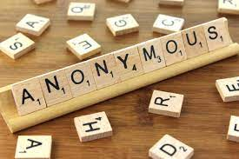


Circumvent Government Censorship:
useful for citizens in countries with authoritarian governments to bypass internet restrictions put in place by their government.
Legitimate uses of the Dark Web
Contact the CIA Anonymously
In 2019, the CIA launched its official presence on the dark web. While the dark web may seem like an unlikely place for a government agency to be present, the website is aimed at people who want to contact the CIA but are concerned about being tracked.
A number of radio sites live on the dark web where you can select the station of your choice.
Notes:
While criminal activity may be the first thing people think of when they hear about the dark web, it does have legitimate uses as well.
Journalists use the dark web frequently (usually via the Tor Project,), especially when they are working on sensitive stories or traveling to foreign countries.
Citizens of oppressive regimes (such as North Korea) use the dark web to safely organize, speak freely and obtain information from reliable news sources. The BBC have a Dark Web presence for this reason.
Many corporate and government whistleblowers rely on the dark web to ensure their safety. Notably, WikiLeaks has a counterpart on the dark web for exactly this reason.

Slide 11
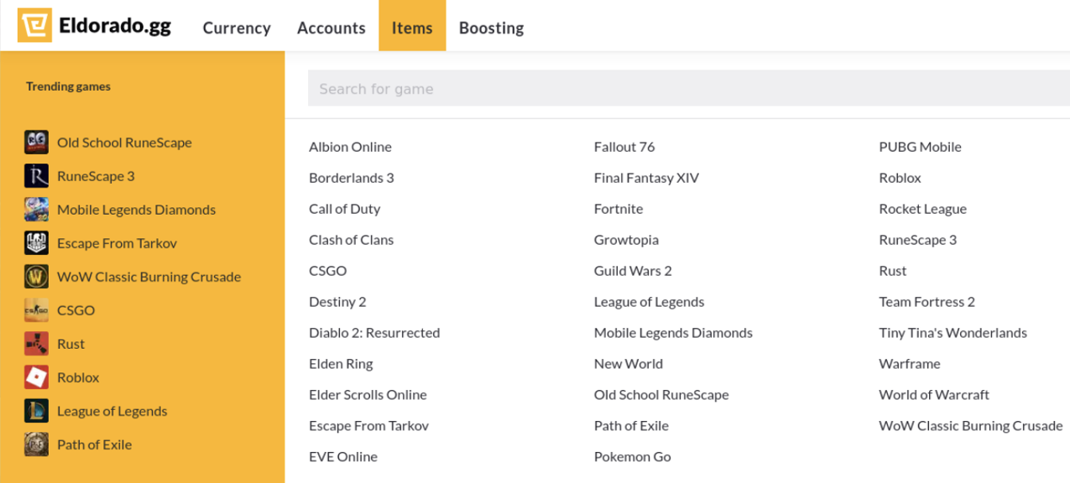
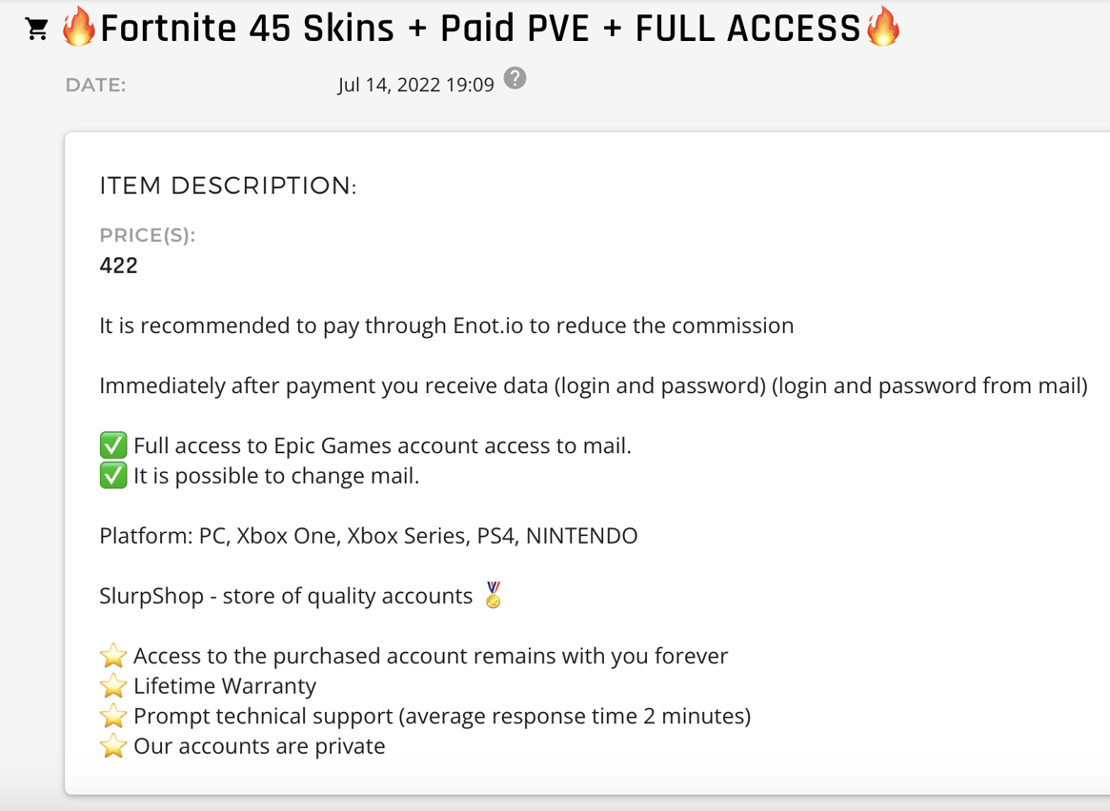
Deep and Dark Web forums and marketplaces
Notes:
As mentioned earlier, data stolen via databreaches or hacks often ends up on the Deep and Dark Web. Underground marketplaces offer cybercriminals a platform for advertising stolen data and selling to the highest bidder. Some sites are set up specifically to sell certain types of stolen data such as gaming accounts or in game items, others offer tools and services to aid cybercriminals in their attacks. On occasion international law enforcement will infiltrate these sites, take down infrastructure and arrest individuals however new services will inevitably fill the gap.

Slide 12

Module Recap
Data breaches occur often and to a wide variety of applications and services, check if your data was involved in a data breach regularly.
The places to check if your data was part of a breach are your email inbox and https://haveibeenpwned.com/
Beware of phishing emails!
If your data was part of a data breach:
Step 1: Stay calm
Step 2: Log in to that account and update your password
More steps in earlier slides.
The Deep Web is a part of the internet not indexed by search engines. The Dark Web includes websites on the Tor network that can only be accessed by a special browser.

Slide 13

Our Module Series
1
What is Cybersecurity and why should we care ?
2
Cyberthreats
3
Dark Web & Breaches
4
Application Security
5
Blockchain, Cryptography & Encryption
6
Personal Digital Security
7
Device Security
8
Assessment
13
Notes:
On this Slide we feature Topics that are available in Future Modules.

